Slide 1
Racial Equity, Human Dignity and Social Justice Advocacy
Colour of Poverty – Colour of Change
January 2013

Slide 2
Racialized group members = First Peoples, Indigenous or Aboriginal ( First Nations, Inuit and Metis ), as well as “peoples” or “communities”-of-colour – whether Canadian born or newcomer
recent studies show the gap between rich and poor in Ontario and across Canada is widening ( ie. Canada’s Colour Coded Labour Market - Canadian Centre for Policy Alternatives and Wellesley Institute, 2011 ), however what is much less well understood is that the impact of this growing gulf is being much more profoundly felt by racialized communities
all too well documented are the numerous structural and systemic racialized disadvantages as experienced by Canada’s First Peoples ( First Nations, Inuit and Metis )
as one becomes aware of these First Peoples realities and lived experiences we need become more familiar, and stand in full solidarity with, the broad First Peoples-led advocacy efforts underway to redress such long-standing racialized institutional and systemic exclusion

Slide 3
First Peoples + peoples of colour
though there are many links between First Peoples struggles and those of other racialized groups – peoples of colour ( or in Federal government language – “visible minorities” ) – in Ontario and across Canada – these chapters focus on the experiences of peoples of colour, including those who are newcomers to Canada – due to the fact that First Peoples claims to justice are distinct and require a additional and different set of Federal Government strategies, comprehensive policy responses, revenue sharing and equitable funding arrangements reflective of First Peoples’ unique and specific historical relationship with Canada
racialized inequity and disparity – intersecting with other dimensions of exclusion – are linked to structures in society & in the economy that have led to the concentration of wealth and economic power in the hands of a few, which at the same time set off the growing “colour-coded” inequality of life opportunities, life chances and life outcomes across Canada

Slide 4
Racialized inequity and disparity
racialized inequity and disparity is a multidimensional phenomenon, encompassing the inability to satisfy basic needs, inadequate control over access to resources, lack of education & skills, lack of shelter, poor health, malnutrition, poor access to water and sanitation, vulnerability to shocks, violence and crime, lack of political freedom, loss of voice in society, etc.
To understand these complex, unique and disproportionate “drivers” of inequity and disparity, we need to look at a number of key indicators –
qualitative indicators that show the constraints poor people face in access to opportunity, quality of life and dignity, within the context of their own communities
quantitative social indicators such as income, housing, health status, educational outcomes, infant mortality, etc.

Slide 5
Understanding the link between “race” and disproportionate disadvantage
in societies dominated by people of white, Caucasian or European backgrounds, First Peoples and peoples of colour have long been targets of discrimination and social exclusion in legal, socio-economic and political spheres. Such groups are said to be racialized or marked, by the dominant group, as inferior. Racialization doesn't just refer to individual beliefs and attitudes toward specific First Peoples or peoples of colour in society, it also includes the institutional, structural and systemic built-in features of society, the way that institutions ( like education, health, social services and the justice system for example ) function – day in and day out
this discrimination against racialized groups has been seen through the era of colonization and colonialism, slavery, the deliberate destruction of communities, racial segregation of schools and neighbourhoods, selective and punitive immigration policies, exploitation of certain groups' labour, over-policing of First Peoples as well as communities of colour, racial slurs, hate crimes, etc, etc.

Slide 6
% Experiencing Discrimination - General Social Survey, 2004 Canada
Aboriginal People 31%
Recent Immigrants 26%
Established Immigrants 18%
Racialized Groups (All) 28%
- Black 36%
- Latin American 36%
Not in Racialized Group 13%
Born in Canada 10%
Gays, Lesbian, Bisexuals 41%
(Heterosexuals 14%)
Youth - higher for immigrant than Canadian-born 34%
% Experiencing Discrimination - Ethnic Diversity Survey, 2002 Canada
Caribbean 41%
Jamaican 51%
South Asian 40%
Latin American 40%
West Asian 28%
Not in Racialized Group 5%

Slide 7
Social Determinants of Equity
the term “social determinants” is often applied in the context of health. According to the World Health Organization, social determinants of health are “the conditions in which people are born, grow, live, work and age, including the health system. These circumstances are shaped by the distribution of money, power and resources at global, national and local levels, which are themselves influenced by policy choices.” Similar factors are readily applicable in determining the life chances or opportunities of people from various marginalized groups including while not limited to racialized communities members.
using Census data as compiled by Statistics Canada, the National Council of Welfare, Campaign 2000, Canadian Centre for Policy Alternatives, G.E. Galabuzi and others have identified five socio-demographic groups as being disproportionately at risk of experiencing persistent low income -
lone parents ( largely single mothers ) with at least one child under age 18
persons with work-limiting physical or mental disabilities
First Peoples ( Indigenous/Aboriginal – First Nations, Inuit, Metis )
peoples of colour
newly arrived immigrants to Canada ( in Canada five years or less – of which almost 85% come from racialized groups )

Slide 8
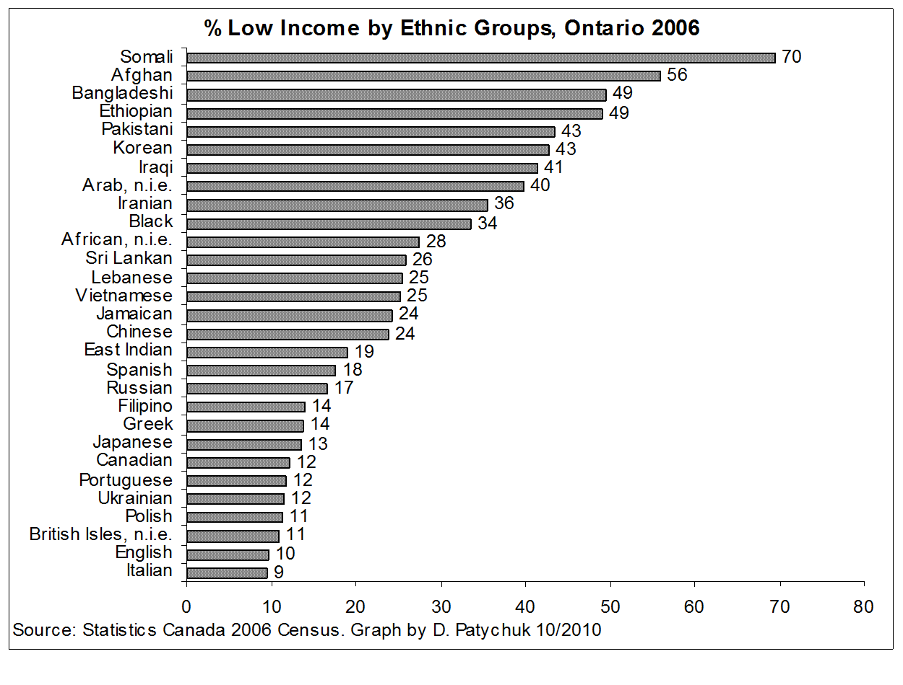
% Low Income by Ethno-Racial Group – Ontario 2006

Slide 9
Racism and the Social Determinants Of Equity
First Peoples and peoples of colour are more likely to fall below the Low Income Cut-Off ( LICO ) – or LIM or Market Basket measures
the United Way Toronto "Poverty by Postal Code" report found that between the years 1980 and 2000 the rate of poverty for Toronto area residents of white, European or Caucasian background or heritage had gone down by 28%, but for residents of First Peoples or other diverse heritages (peoples of colour) the poverty rate had gone up by – 361%
individual and systemic racism plays a large role in creating such problems
such prejudice and discrimination mean that First Peoples and peoples of colour are less likely to get jobs when equally qualified ( Oreopoulos, May 2009 ) and are likely to make less income than their white peers ( Canada’s Colour Coded Labour Market, 2011 )
they are more likely to live and work in poor conditions, to have less access to healthcare and related supports, and to be victims of police violence ( Colour of Poverty Campaign - Fact Sheet # 7, 2007 and Working Rough Living Poor – Access Alliance Multicultural Health & Community Services - June 2011 )
Colour Coded Health Care - The Impact of Race and Racism on Canadians’ Health ( Wellesley Institute – January 2012 ) – documents the reality of racialized health inequities and disparities

Slide 10
Greater Trouble in Greater Toronto – Child poverty in the GTA (Children’s Aid Society of Toronto - 2008)
Poverty is racialized, that is, disproportionate to people of colour who are Canadian-born and newcomers. Among broad ethno-racial groups in the Toronto CMA, the 2000 Low Income Cut-Off-Before Tax ( LICO-BT ) rates of child poverty were about –
one child in ten in low income among global European groups
one child in five for East Asian groups
one child in four for Aboriginal, South Asian, Caribbean, South & Central American groups
one child in three for children of Arab and West Asian groups
one child in two for children of African groups
And –
rates of LICO-BT family poverty among two-parent families in 2000 range from between 5% for European groups to 29% for Arabic and West Asian groups
rates of family poverty among female lone-parent families range from between 26% for European groups and 65% for African groups

Slide 11
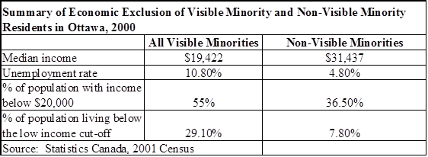
Racialization of poverty not a “Toronto phenomenon”
using the 2006 Canadian Census data, the Hamilton Roundtable for Poverty Reduction reported that 18% of Hamilton’s residents live in poverty. Yet when looking at different sub-populations the rates are much higher - children under 14 (24%), seniors age 65 and older (24%), disability community members (30%), First Peoples (44%), peoples of colour (37%), as well as recent immigrants (52%) (Hamilton Roundtable for Poverty Reduction, 2008)

Slide 12
Precariousness and Racialized Disadvantage
a key contributing factor behind these province wide trends is the concentration of economic, social and political power in fewer and fewer hands that has emerged as governments have moved away from their regulatory role in the economy. The experience of disadvantage includes powerlessness, marginalization, voicelessness, vulnerability, insecurity and exclusion - thus the various dimensions of the experience of disadvantage interact in important ways to reproduce and reinforce social exclusion
Example - precarious employment is the fastest growing form of work - contract, temporary, part-time, piece work, shift work or self-employment - precarious forms of employment are defined by low pay, no job security, poor and often unsafe working conditions, intensive labour, excessive hours and low or no benefits. First Peoples, peoples of colour, women, persons with disabilities and recent newcomers are all disproportionately over-represented in such precarious work

Slide 13
Ontario government commissioned “The Review of the Roots of Youth Violence” ( Curling and McMurtry, 2008 )
“were taken aback by the extent to which racism is alive and well and wreaking its deeply harmful effects on Ontarians and on the very fabric of this province”
“The very serious problems being encountered in neighbourhoods characterized by severe, concentrated and growing disadvantage are not being addressed because Ontario has not placed an adequate focus on these concentrations of disadvantage despite the very serious threat they pose to the province’s social fabric. Racism is becoming a more serious and entrenched problem than it was in the past because Ontario is not dealing with it”
“articulate more effectively its commitment to anti-racism and address this urgent issue as a major priority…” and
“lay the foundation for the extensive action required to address this growing problem, the Province should proceed immediately to develop the methodology for the collection of race-based data in all key domains”

Slide 14
To address growing colour-coded wealth, income and opportunity gaps we require targeted strategies
we need a comprehensive, multi-sector response to racialized inequity and disparity with adequate policies and programs from all orders of government ( federal, provincial-territorial, municipal and First Peoples ), aimed at mitigating the growing experience of disproportionate disadvantage among racialized groups ( as an example - Ontario’s Equity and Inclusive Education Strategy )
we need incorporate critical race or anti-racism analysis into our approach to understanding racialized disadvantage as a structural problem – it’s essential as a starting point for building and moving forward effective racial equity and racial justice strategies, policies, programs and practices
an anti-racism analysis in a policy context requires policy makers to examine the potential impact of their policies – both negative and positive – on racialized communities and other disadvantaged groups - and to eliminate institutional, structural and systemic discrimination that results in barriers to the full integration and equal participation by members of these racialized and otherwise disadvantaged communities
“targeted universalism” - building into programs that are universally accessible, measures that are specifically targeted to the most vulnerable groups - see john powell of the Kirwan Institute – discussion of implicit bias, structural racialization and “targeted universalism”

Slide 15
Colour of Poverty – Colour of Change Principles for Racial Equity, Human Dignity, Social Justice
1) Reduce racial disparities-inequities by focusing on racial equity-human dignity-social justice outcomes
2) Work to expand fair access to institutions and opportunities ( ie. educational, regulatory, vocational, training, etc ) and public benefits ( ie. social housing, health and healthcare, seniors benefits, welfare, etc ) for members of racialized communities
3) Advance enfranchisement for members of racialized communities (ie. municipal franchise for all residents )
4) Promote economic equity and justice ( ie. work to uphold and expand employment equity, work to extend the coverage and strengthen the enforcement of employment standards and workplace safety regimes, work to ensure the equitable and timely access to opportunities to practice ones profession or trade, etc )
5) Seek investments in opportunity and advancement ( ie. expanded equitable access to public services, strengthened work-force opportunities, community development, etc ) for members of racialized communities

Slide 16
Colour of Poverty – Colour of Change Principles for Racial Equity, Human Dignity, Social Justice
6) Protect against discrimination, racial violence and racial profiling - work to ensure the enforcement of policies to end discrimination based on race, ethnicity, faith, nationality, immigration status and other related grounds
7) Recognize and work to help deliver inherent Aboriginal and Treaty rights as well as First Peoples sovereignty, self-determination and self-government
8) Recognize and meaningfully engage the contributions of all ethno-racial and cultural communities - design initiatives that build upon diverse values, languages and cultural histories and that end racial and cultural inequities
9) Work to ensure that racial equity-human dignity-social justice efforts are adequately funded and effectively resourced
10) Work to ensure that stated racial equity-human dignity-social justice goals and objectives are measurable and enforceable with mechanisms in place to monitor such outcomes ( ie. disaggregated data collection and analysis, the strengthening of community-based legal clinics, enhanced human rights protection, charter case and other legal challenge funding, etc )

Slide 17
Naming colour-coded or racialized disadvantage
by naming, recognizing and more fully appreciating the long-standing systemic inequality we can better identify and implement targeted and complementary interventions and approaches that are needed in order to deliver change
such naming is increasingly more important given the ever-changing, ever-diversifying demographic make-up of the province – and given the ever more “colour-coded” and ethno-racially and community-specific nature of the disproportionate disadvantage and growing inequality across Ontario
we need more in-depth critical thinking on the impact of the structural & systemic barriers and obstacles – as well as on the nature of fair and equitable life chances, life opportunities and life outcomes for First Peoples and peoples of colour
new tools, resources, studies and reports can build and deepen the needed broad-based shared "ownership" of these values, principles, perspectives, issues and challenges – as well as the critically needed targeted policy and program responses and prescriptions – such as provincial-territorial-municipal employment equity legislation and the coherent and consistent collection – and analysis – of ethno-racially and otherwise appropriately disaggregated data
such a critical consciousness and awareness is the necessary foundation upon which we can then best build and develop policies, programs and practices that will remedy the underlying exclusions, discriminations and “drivers” of the disadvantage as faced by racialized groups and communities in Ontario

Slide 18
Targeted Policy Priorities – to address the structural and systemic nature of racialized disadvantage
Example # 1 - First Peoples -
Assembly of First Nations
Vision - It’s Our Time to Fulfill our Rightful Place as Indigenous Nations
1) Supporting First Nation Families
2) Exercising and Implementing Our Rights
3) Advancing Economic and Environmental Interests
4) Supporting First Nation Governments and Nation-Building
5) Advocating for Change within our Communities and Organizations

Slide 19
SUPPORTING First Nations Families
1) SUPPORTING First Nations Families - AFN will work with and support First Nations to ensure respect for, well-being of, and opportunity for, First Nations youth, families and communities. Through education and skills training, we have an opportunity to overcome the attempts of the residential school system to destroy our culture and language by dividing our communities and families. This is our time to use education as our tool to retain and maintain the strength of First Nations languages, history, teachings and values while facilitating better understanding between First Nations and the rest of Canadian society. First Nation families and communities must be fully supported in fulfilling their roles in securing success and opportunity for their children. The rebuilding of families and communities will promote First Nations participation in strong and sustainable economies locally and nationally. This is our time to empower our fast growing youth population in ways that will ensure a future of opportunity, success and prosperity. The voices of our youth must be heard, understood and included.

Slide 20
EXERCISING and Implementing Our Rights
2) EXERCISING and Implementing Our Rights - AFN will be grounded by the full understanding that First Nations have inherent jurisdiction as indigenous peoples of this land. In a focused and inclusive manner, the AFN will support First Nations to implement our sacred treaties and our constitutionally protected title and rights using clear standards, such as those set out as a minimum in the United Nations Declaration on the Rights of Indigenous Peoples. It is our time to take steps to implement First Nations inherent rights and jurisdiction by supporting traditional governance, achieving acceptable consultation and accommodation standards and securing resource revenue sharing.

Slide 21
ADVANCING Economic and Environmental Interests
3) ADVANCING Economic and Environmental Interests - AFN will support First Nations in pursuing a vision of sustainable economic self-sufficiency achieved by ensuring investments in stable community infrastructure and effective business partnerships. By being active participants in economic development, we can better ensure First Nations economies thrive, creating wealth and jobs and supporting our people to have an active role in shaping the national economy. It is our time to take a leadership role as indigenous peoples to balance development opportunities and conservation of the earth through environmental protection and green development.

Slide 22
SUPPORTING First Nation Governments and Nation Building
4) SUPPORTING First Nation Governments and Nation Building - AFN will support First Nations, as the rightful holders of title, rights and as signatories to treaties, to engage with governments and serve their citizens wherever they may reside, based on the full recognition of the autonomy, diversity and interdependence of First Nations. AFN will advocate for full recognition of First Nations’ jurisdiction and sustainable transfer agreements based on real costs across all policy areas such as education, illness prevention and treatment, children and families, justice and others that support and build our government and service capacity. AFN will support First Nation governments advance core interests and responsibilities such as citizenship and leadership selection. It is our time to re-build our nations by unifying our voice and taking the necessary steps toward the full and final displacement of the Indian Act.

Slide 23
ADVOCATING for Change Within Our Communities and Organizations
5) ADVOCATING for Change Within Our Communities and Organizations - AFN will be truly an "Assembly of Nations" providing political advocacy, support and coordination for First Nations to unite with collective strength to rebuild our nations. AFN will be a welcoming and supportive asset to First Nations in all advocacy efforts in Ottawa and elsewhere. AFN will advocate for fundamental change in funding relationship pursuant to sustainability review, fund-raising and ensuring adherence to the functions as described in the Charter.

Slide 24
Targeted Policy Priorities – to address the structural and systemic nature of racialized disadvantage
Example # 2 – peoples of colour -
Colour of Poverty – Colour of Change
1) Establish an Equity and Anti-Racism Directorate to provide for the collection and analysis of ethno-racially and otherwise appropriately disaggregated data across all provincial Ministries and public institutions. The Directorate – with a pan-provincial government-wide mandate – would complement this data analysis by providing an ongoing monitoring and program development role for the integrated implementation of inclusive and comprehensive equity and anti-racism policies and practices - with complementary transparent and accessible accountability frameworks.
2) Establish an Employment Equity Secretariat fully mandated and adequately resourced in order to implement a mandatory and comprehensive provincial employment equity program in Ontario.

Slide 25
Example # 2 ( cont’d ) – peoples of colour - Colour of Poverty – Colour of Change
3) Amend and augment the provincial funding formula for publicly-funded elementary-secondary schools by introducing an Equity in Education Grant – a redistributive mechanism rooted in a range of relevant equity and diversity measures and considerations – to ameliorate Ontario’s growing ethno-racially defined learning outcome inequities and disparities.
4) All Federal, Provincial and Municipal investment strategies and stimulus packages incorporate a strong set of equity objectives and targeted initiatives and outcomes. Federal investments must extend the Employment Equity Act by attaching such requirements to all inter-governmental and other financial transfers and allocations. These same principles must also be effectively and consistently applied toward all current and future public investments – such as all “green” energy, “green” industry or “green” collar job-creating initiatives – so that in this way stable and sustainable futures for ALL in Ontario can be best pursued both economically as well as socially.

Slide 26
Example # 2 ( cont’d ) – peoples of colour - Colour of Poverty – Colour of Change
5) Develop comprehensive integrated and equitably inclusive curriculum as well as complementary program and product development capacity across the entire Ontario publicly funded educational system - not only at elementary and secondary levels, but also in the post-secondary, tertiary, adult learning and diverse multi-media environments – including print media, television, radio and new media.
6) Strengthen employment standards legislation to protect and effectively enforce all workers’ rights - particularly for those working in various forms of precarious employment.
7) End the 3 month OHIP waiting period for all newcomers to the province.

Slide 27
Example # 2 ( cont’d ) – peoples of colour - Colour of Poverty – Colour of Change
8) Provide the municipal franchise ( right-to-vote ) for all persons physically resident in this province regardless of their current citizenship status.
9) Address and end racial and faith-based profiling and its inter-sectionality in the criminal justice system, in the school systems of the province as well as in all other institutional environments.
10) Strengthen human rights protection and enforcement to more effectively deal with race based discrimination in the workplace - as well as in all other contexts and environments.

Slide 28
Example # 2 ( cont’d ) – peoples of colour - Colour of Poverty – Colour of Change
11) Restructure legal aid and make it truly accessible for the racialized working poor, provide increased support for legal clinics which address the needs of racialized communities and set up a provincially funded Court Challenges Program.
12) Create strong legislation that will mandate trade and professional regulatory bodies to remove all barriers to accreditation and employment as now faced by internationally trained and educated trades-people and professionals.
13) Establish clearly identified goals and specific benchmarks and indicators in order to best measure and monitor the progress of any poverty reduction strategy and implementation plan as they relate to racialized as well as other historically disadvantaged and marginalized communities.

Slide 29
Example # 2 ( cont’d ) – peoples of colour - Colour of Poverty – Colour of Change
14) The provincial government needs to clearly articulate and adopt an enabling legislative framework – which would also provide for all the necessary powers and authorities – so that Municipal governments that are interested can effectively and creatively implement Inclusionary Housing – Inclusionary Zoning by-laws, provisions and programs.
15) It is necessary to expand the waiting list priority setting process around access to affordable housing – linking it to prevailing local-regional socio-economic inequity and disparity – so that in the same way that we often rightly prioritize or fast-track single mothers, youth or others – we need consider the other critical historically and socially imbedded disadvantage – impacting peoples of colour, First Peoples and persons with disability.

Slide 30
Example # 2 ( cont’d ) – peoples of colour - Colour of Poverty – Colour of Change
16) In working for an equitable, inclusive and sustainable economic future - from energy audits in urban centres, solar panels, windmills and biomass to new transit spending – green jobs should mean critical investments in both long-disadvantaged communities as well as those that have been recently among the hardest hit. We need build an equitable and inclusive green economy strong enough to lift ALL people out of poverty. In working together to advocate for real local, provincial as well as federal commitments to job creation – and the related employment training opportunities to allow for full, fair and equitable access to the future green economy – most especially for people from historically disadvantaged groups and communities – we’re able to fight poverty, build equity and social justice as well as help prevent environmental degradation. So in the midst of economic upheaval it is time to make the connections, broaden our shared understanding and together clearly identify the intersections between equity, economic fairness, good jobs and justice for all Ontarians – equity, inclusion and shared pathways to fairness, justice and sustainability.

